Slide 1

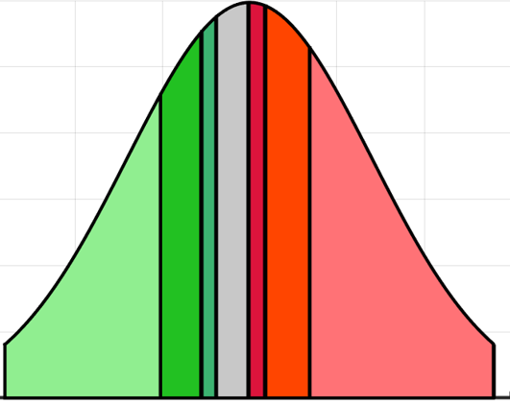
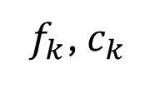

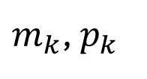
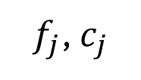

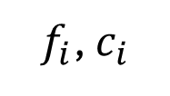

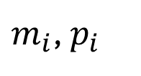

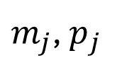

Synthesized Speculation Gambling System
Black Box Architecture
(to Users)
Bet Slicing
$m_{k}$, $p_{k}$
$$m_{i}$$
$m_{j}$, $p_{j}$
Winning Condition
Peer Bet
$$\$5$$
Stake
Payout
$m_{i}$, $p_{i}$
Peer Bet
Winning Condition
$$\$5$$
Stake
$$…$$
Payout
Remaining Slice
Peer Bet
Winning Condition
$$\$5$$
Stake
Payout
Peer Bets
Change
$f_{i}$, $c_{i}$
$f_{j}$, $c_{j}$
$f_{k}$, $c_{k}$
Iterative Money Line
Money Line Positions
For Every Player
Winning Condition
Stake
Payout

